Slide 1


Hospital Charges Prediction
By : Muhammad Julizar

Slide 2
Background
At this time maintaining body health is very important. This is because having a healthy and fit body can prevent the body from getting sick. therefore health insurance is needed.

Slide 3
Dataset : Medical Cost Insurance
Objective : Predict Hospital Charges using The Best Regression Model

Slide 4
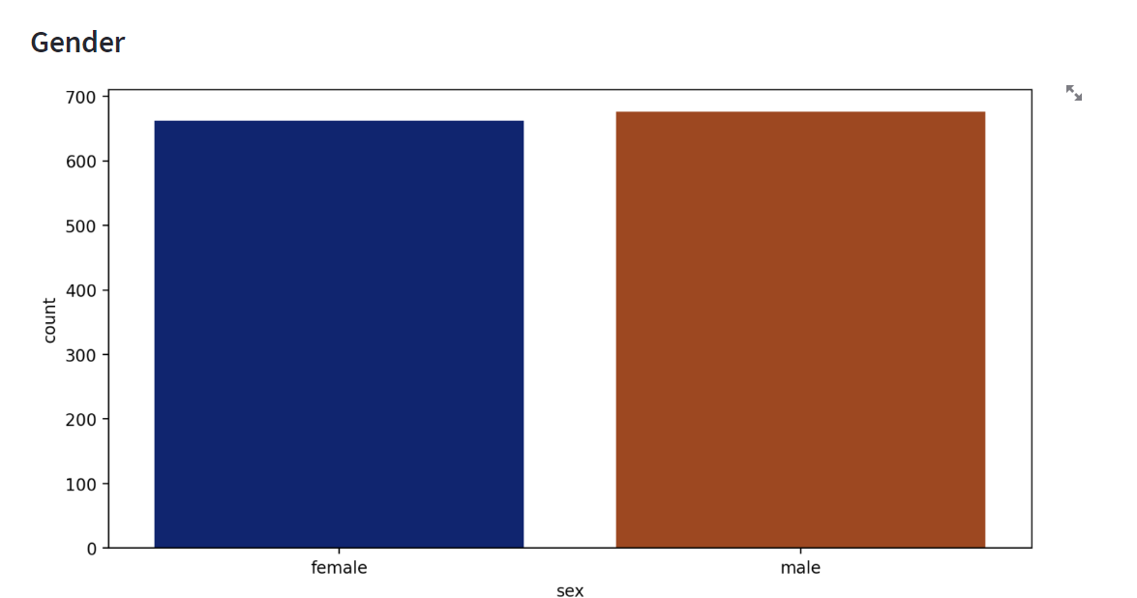
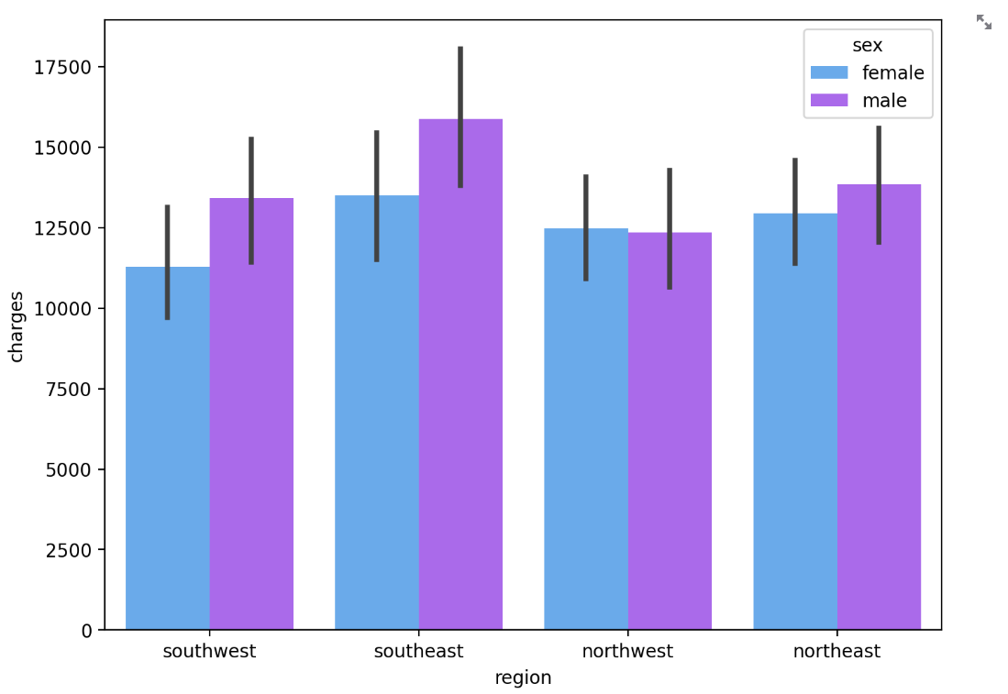
Customer Gender
Charges per region by Gender
most of the highest charges is by male

Slide 5
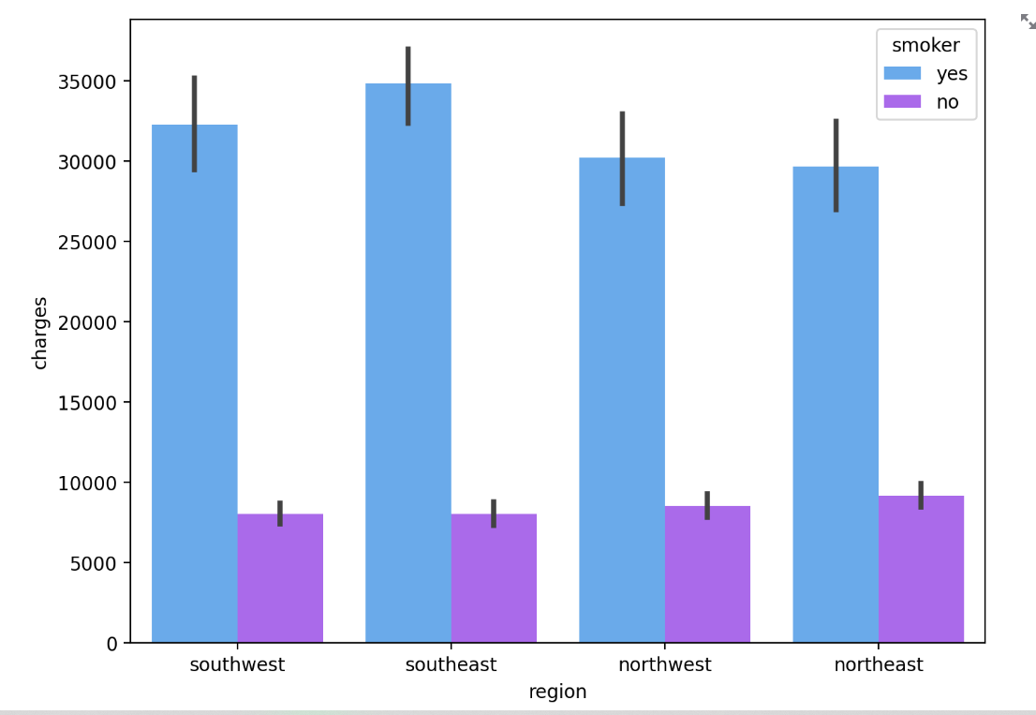
Charges per region by Smoker
The differences between smoker and not smoker.
Smoker behavior can increase the hospital charges.

Slide 6
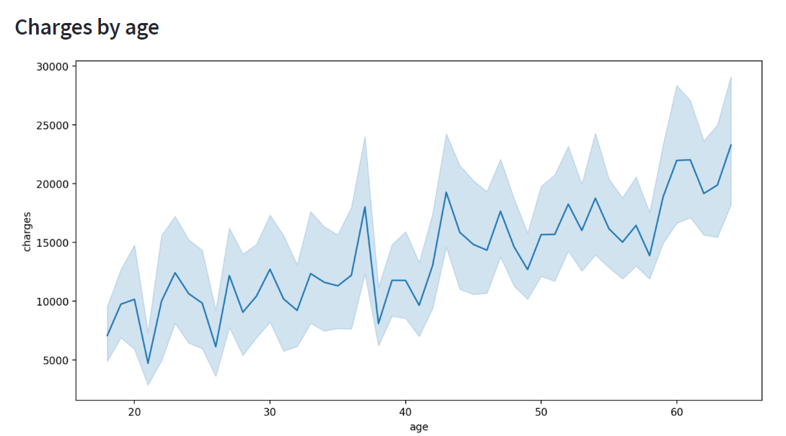
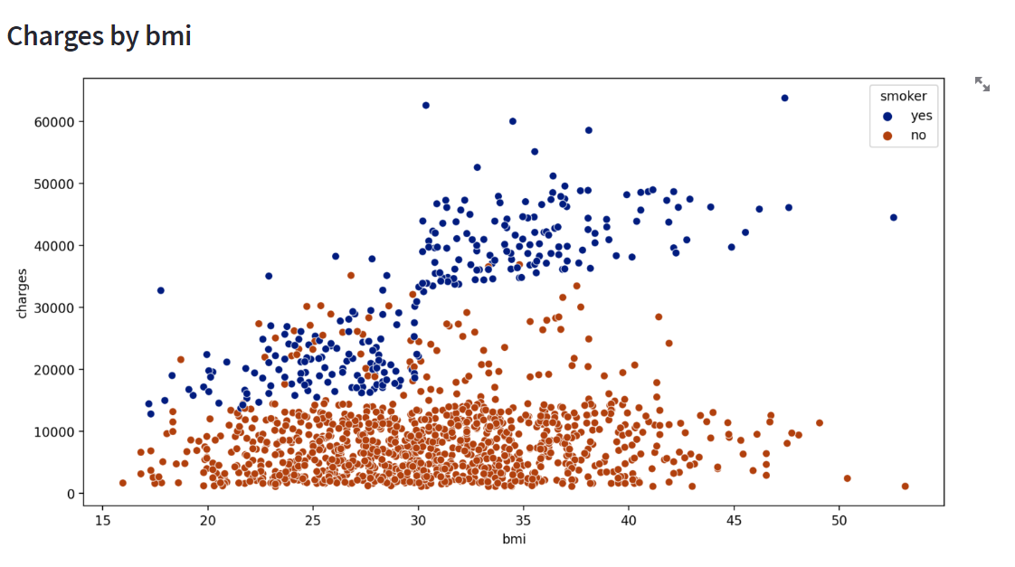
Total Charges by age and BMI
When people getting older it will increase total hospital charges
And we can see in smoker so affect the total charges

Slide 7
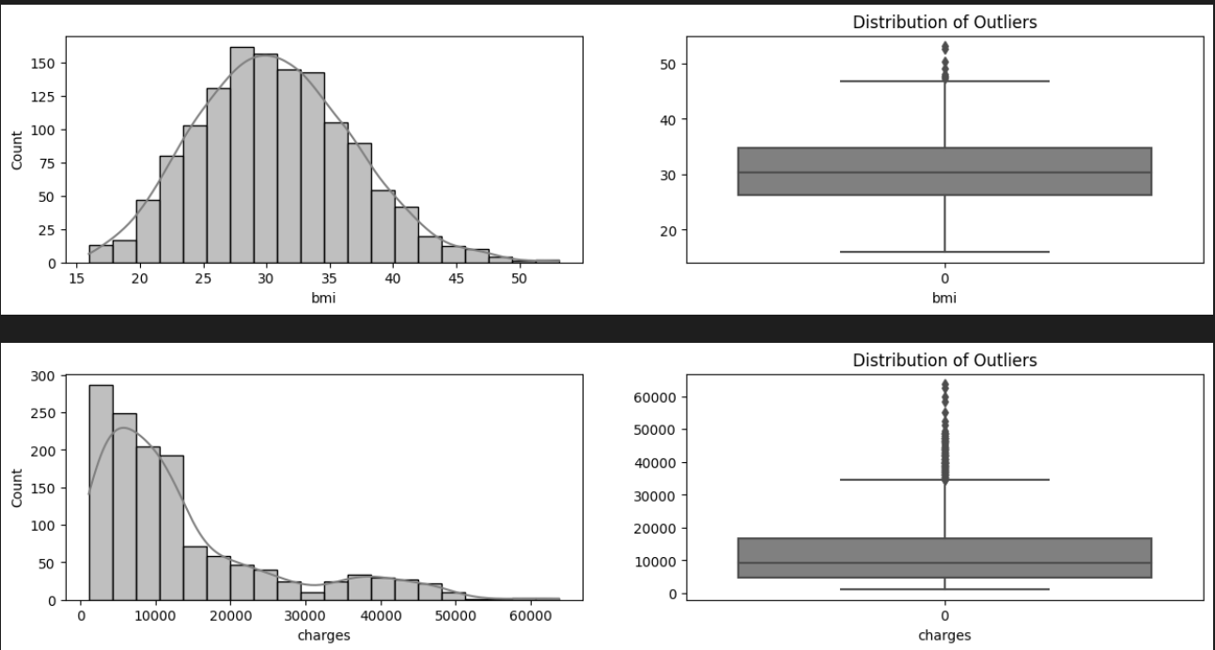
Distribution Data

Slide 8
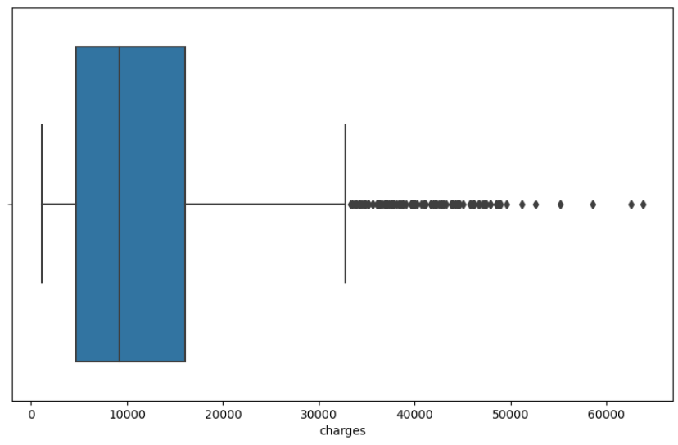
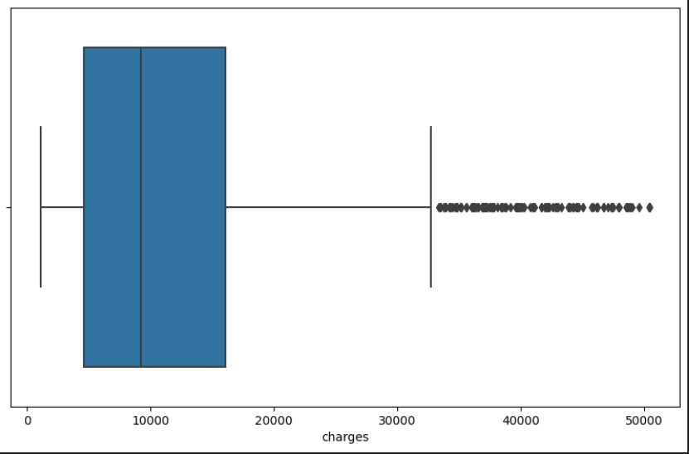
Outliers
Before handling outlier
After Handling outlier

Slide 9
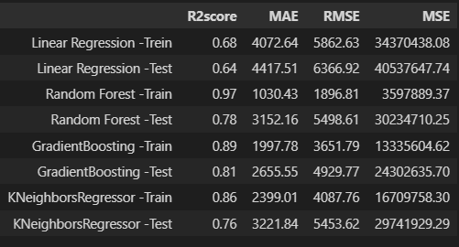
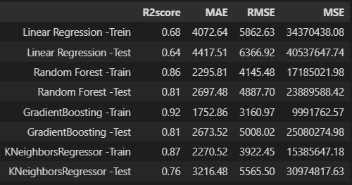
Base model evaluation

Slide 10
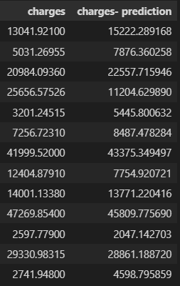
Prediction Inference Data
Customer Gender

